Slide 1
South Maui At The Tipping Point
Notes:
<number>

Slide 2
Tipping Points
"the levels at which the momentum for change—whether desirable or undesirable—becomes unstoppable"
Notes:
<number>

Slide 3
Is Maui Nui At A Tipping Point?
Are we facing:
"the levels at which the momentum for change—whether desirable or undesirable—becomes unstoppable"
Notes:
<number>

Slide 4
Maui Nui’s “Tipping Points”?
“A plague of problems only… getting worse. We are rapidly losing green space, beaches and marine life; our sewers are overflowing; our limited water supply is being rapidly depleted; our soil, water and food are found contaminated by toxic chemicals…
Notes:
<number>

Slide 5
Maui Nui’s “Tipping Points”?
Hawai’i’s economy creates mostly low-paying jobs servicing tourism, burdening many local residents with low wages, costly housing and a cost-of-living 35% higher than on the Mainland.
Notes:
<number>

Slide 6
Maui Nui’s “Tipping Points”?
Our political process is characterized by personalities over issues, low voter participation, band-aid remedies and trivial reforms, and corrupt links between developers and politicians.”
Ira Rohter, A Green Hawai'i
1992
Or
Notes:
<number>

Slide 7
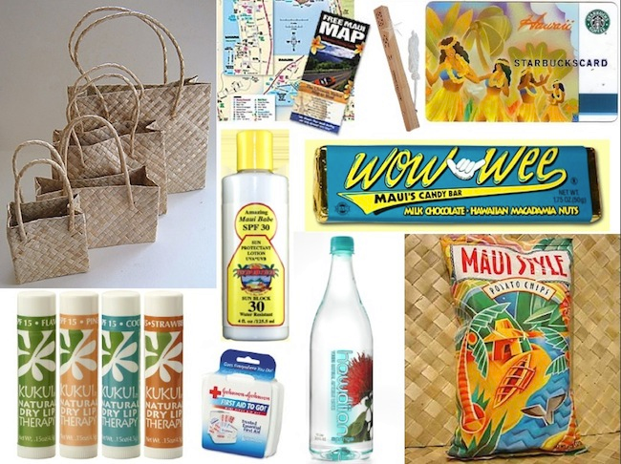
Maui Nui’s “Tipping Points”?
Do you prefer a more sustainable economy;
where Maui-produced goods replace many imports;
Notes:
<number>

Slide 8
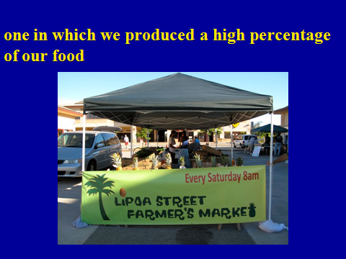
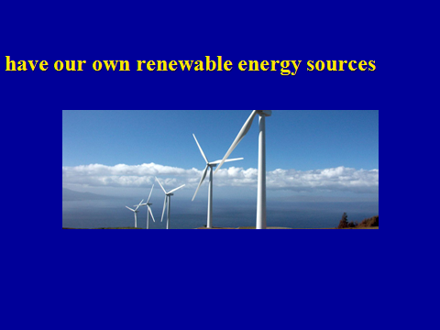
one in which we produced and marketed a
high percentage of our food;
expand our own renewable energy sources;

Slide 9
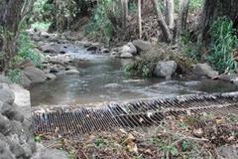
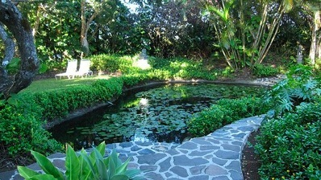
restore natural waterways;
promote traditional agriculture;

Slide 10
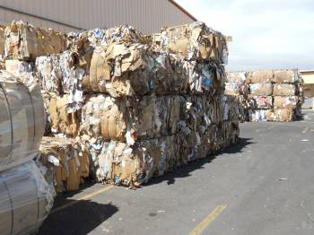
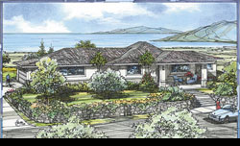
significantly reduced and recycled waste;
where there’s affordable housing for all of us;

Slide 11

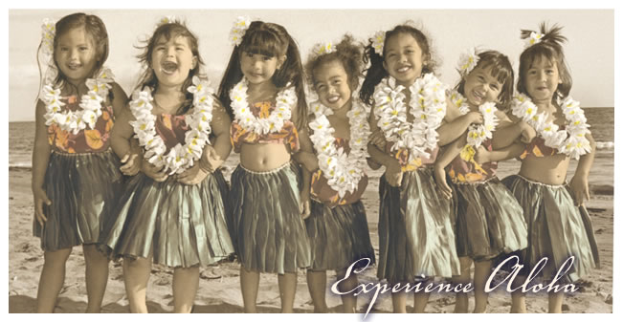
a diversity of jobs away from just tourism & construction—including many “green collar”
jobs;
and retention and expansion of Maui’s historical and cultural heritage and our precious aina.
Notes:
<number>

Slide 12
Maui Nui’s “Tipping Points”?
Those choices are out there, available to us today.
However, when those choices are made, we must also realize that Maui County is a small group of islands with very finite resources—and that South Maui is just a part of it.
Our carrying capacity now and for the future is severely limited.
Notes:
<number>

Slide 13
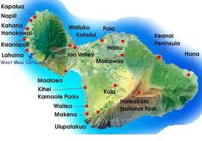
Carrying Capacity
“The maximum number of individuals that a given environment can support without detrimental effects.”
Notes:
<number>

Slide 14
Carrying Capacity
For an island such as Maui the World Tourism Organization uses a technical definition—that carrying capacity represents:
“the maximum number of people who may visit a tourist destination at the same time, without causing destruction of the physical, economic and socio-cultural environment and/or an unacceptable decrease in the quality of visitors' satisfaction” .
Notes:
<number>

Slide 15
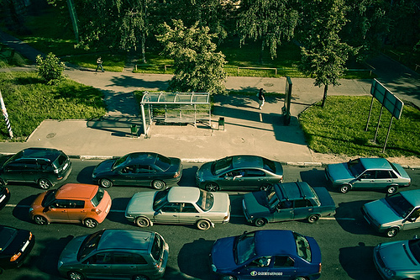
Carrying Capacity
Or, in everyday terms…
how much congestion and traffic jams…

Slide 16
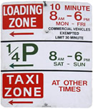
high energy prices…
parking restrictions…

Slide 17

polluted and overcrowded beaches…
HHow many more crowded beaches
How many more crowded beaches
H

Slide 18
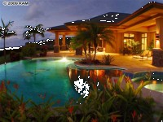
watering restrictions…
“McMansions” built in gated communities…

Slide 19
and costly imported food and goods can we afford?

Slide 20
Carrying Capacity Factors Become Interrelated
Population
Growth
Transportation
Housing
Infrastructure
Jobs
Water
Tourism
Impact

Slide 21
Any attempt at long-range planning tries to stay within acceptable parameters.
Nevertheless, initial resident population growth estimates for Maui were almost 11% below actual 2010 numbers—and indeed 2010 Maui resident population topped the projected 2015 levels by 3%. Given that growth rate, it’s plausible that by 2030 total de facto population—residents plus visitors could near 280,000. Where will everyone live, work, be schooled, play, etc?
And yet, even the original projections did not take into account The Great Recession and effects of spiraling energy costs.

Slide 22
Actual Versus Projected 2010 Maui County Resident Population
Notes:
<number>

Slide 23
De Facto Population 1980 - 2030
Projected 2030 Visitor Population Will Be 36% Above 2010
Resident population
Visitor population
Notes:
<number>
Historical and Projected Population, Island of Maui

Slide 24
Maui County Population Forecast By Age
Number of People
DBEDT 2030 Series July 2005
Age
By 2020—only nine years away—the percentage of Maui’s
population aged 60 and up will have increased over 55% while the
estimated population below the age of 15 will rise only slightly.
Notes:
<number>

Slide 25
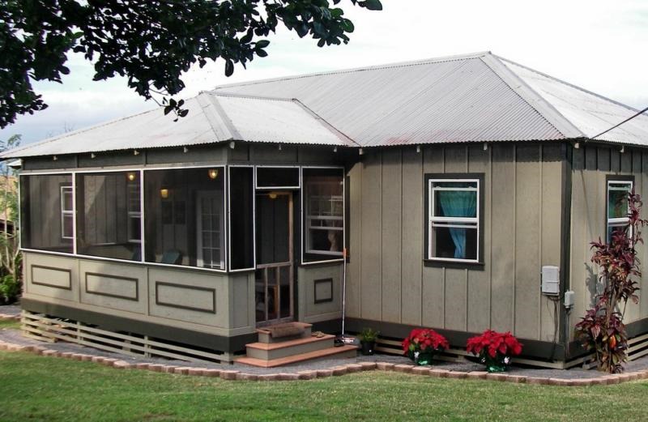
Housing & Land Development
Both Crisis & Dilemma
Where will everyone live, what mix will there be between single
and multi-family homes and how much affordable versus
luxury housing will be built?
Notes:
<number>

Slide 26
From 2000 through 2007—pre-Great Recession—the average sales price of a single family house rose 130% while over the same period
average sales price of a condominium increased 240% and
average sales price of an “affordable home” went up 36%.

Slide 27
Given those trends, is there any doubt, then, why developers hesitate—or prefer not—to build “affordable homes”? Or, that developers seem driven to build ultra-high-price sprawling “McMansion” second-homes in gated hide-aways for offshore cliental rather than multi-family or affordable market-level priced homes?
And yet most Maui citizens participating in a county-wide planning exercise expressed fears that new housing would not be affordable or even built for long-term residents.
Notes:
<number>

Slide 28
Over 95% of the planning exercise participants said they wanted all future housing developments to contain from five to ten units an acre AND cluster most development into urban expansion areas in Central Maui and Kihei. They clearly indicated a strong desire for creating more compact developments.
And a large majority in that planning exercise stressed the continuing need to preserve open space, to protect agricultural and coastal lands, and to protect historic and cultural sites.
Notes:
<number>

Slide 29
Maui Island Residential Dwelling Units
by Single-Family or Multi-Family Unit in 2005
Is there an optimum or more desirable mix for new
single family versus multi-family housing units?
Notes:
<number>

Slide 30
Jobs Forecast
Unfortunately, current projected job increases will
fall far below projected population gains.
Notes:
<number>

Slide 31
Projected Employment Shifts 1990 - 2030
By 2030, a lower percentage of
service, government, agricultural,
manufacturing, construction,
transportation/commerce/
utilities, and banking &
finance jobs.
Agricultural jobs under these
projections will halve.
1990
Only the self-employment
sector is seen as rising.
2030
Notes:
<number>

Slide 32
Already Ten of Maui’s Largest Occupations are Related to Tourism
Number
Notes:
<number>

Slide 33
But Even The Five Highest Paying 2008 Maui County Visitor Industry Salaries All Fell Below The Statewide Overall Average Wage
Notes:
<number>

Slide 34
How Maui Residents Perceive Tourism
Source: Economic Research Institute, 2007
Notes:
<number>

Slide 35
How Maui Residents Perceive Tourism
Source: Economic Research Institute, 2007
Notes:
<number>

Slide 36
Infrastructure
Without adequate infrastructure how can there be any of the projected surges in population, all the proposed developments, influxes in tourism and the shifts in job types and location?
Even now a lack of adequate revenue sources means too much of Maui’s key infrastructure is already overworked & outdated at the same time that capital expenditures are lagging.
Notes:
<number>

Slide 37
Maui County Revenues & Expenditures
1994 – 2009
$-millions
From 1994 through 2009, Maui County revenues grew at an average rate above 5.5% and yet, in just over half of those sixteen years revenues exceeded expenditures
Notes:
<number>

Slide 38
Maui County Revenues & Expenditures
1994 – 2009
$-millions
But, while infrastructure—capital—expenditures averaged 14% of total budget expenditures from 2000 through 2004, that percentage dropped to only 10% starting in 2005 and 2006.
Notes:
<number>

Slide 39
Inadequate Infrastructure
Water
Iao Aquifer constructed from 1940 through the 1980’s is being pumped beyond any sustainable yield.
Regional Central Maui distribution source constructed in 1970’s & 1980’s and needs constant maintenance.
Plantation ditch system goes back to the 1800’s and requires constant maintenance.
Notes:
<number>

Slide 40
Inadequate Infrastructure
Water
Sewage Treatment
Wailuku – Kahului wastewater reclamation facility constructed in early 1970’s and needs tsunami and shoreline fortification.
Lahaina wastewater reclamation and collection system goes back to mid-1970’s and the earliest facility already is off-line.
Kihei wastewater reclamation facility was constructed in 1975 and has capacity remaining.
Regional transmission line built in 1970’s & 1980’s and needs constant maintenance.
Notes:
<number>

Slide 41
Inadequate Infrastructure
Water
Sewage Treatment
Schools
Baldwin High built in 1938—over-capacity.
Maui High built in 1971—over-capacity.
Lahainaluna High built in 1831.
Iao Intermediate built from 1930’s – 1980’s and is over-capacity.
Kihei high school students still bused to Central Maui.
Notes:
<number>

Slide 42
Inadequate Infrastructure
Water
Sewage Treatment
Schools
Roads
Kaahumanu Avenue built pre-1959—now, over-capacity.
Honoapiilani Highway pre-1959—now, over-capacity.
Pi’ilani Highway built 1981—if more South Maui development occurs, will be far beyond its capacity.
Hana Highway built starting in 1930’s and now over-capacity in many segments.
Notes:
<number>

Slide 43
Inadequate Infrastructure
Water
Sewage Treatment
Schools
Roads
Harbors, Government & Hospitals
Kahului Harbor dates to 1900’s and is nearing capacity.
County offices newest building is almost 40 years old and way over-capacity.
Maui Memorial Hospital main building constructed in 1952; no current South or West Maui facilities.
Notes:
<number>

Slide 44
Inadequate Infrastructure
Parks & Recreation
Existing acreage already over 60% below current demands and by 2030 may be nearly 275% below predicted demands. Even the new South Maui park does not satisfy demand.
Notes:
<number>

Slide 45
Inadequate Infrastructure
Parks & Recreation
Notes:
<number>

Slide 46
The South Maui Context
So, how will South Maui—a region projected to absorb Maui County’s largest relative growth—be able to cope with its already rapidly expanding demand for jobs, food, housing developments, energy, education, and available health care amid an already overtaxed infrastructure?
Notes:
<number>

Slide 47
South Maui 2010 Census of nearly 29,000 is
only 3% below the initial projected 2015
South Maui 30,000 estimate
2010
Population
28,892
Residents
2010
Housing Units
10,889 Occupied
&
7,710 Vacant
(43%)
of 18,059
total

Slide 48
Maui Resident Population 2000 - 2030
South Maui 2010 Population Already Nears Projected 2015 Level

Slide 49
Maui Resident Population 2000 - 2020
Maui Island Population Forecast by Communities
Notes:
<number>
Projected Resident Population, Maui Regions

Slide 50
Maui Resident Population 2000 - 2020
Projected Changes for Three Key Community Plan Areas
+ 72%
+ 70%
+ 61%
Notes:
<number>
Projected Resident Population, Maui Regions

Slide 51
The Housing Mix Dilemma
Where should the projected types of housing be located?
Single Family
Multi-Family
Notes:
<number>

Slide 52
Given That The Ideal Solution Locates Jobs Near Housing Here Are Projected Jobs by Community Plan Areas
Notes:
<number>
Projected Jobs, Maui Regions

Slide 53
Projected Job Gains by Community Plan Areas
+33%
+104%
+22%
Notes:
<number>
Projected Jobs, Maui Regions

Slide 54
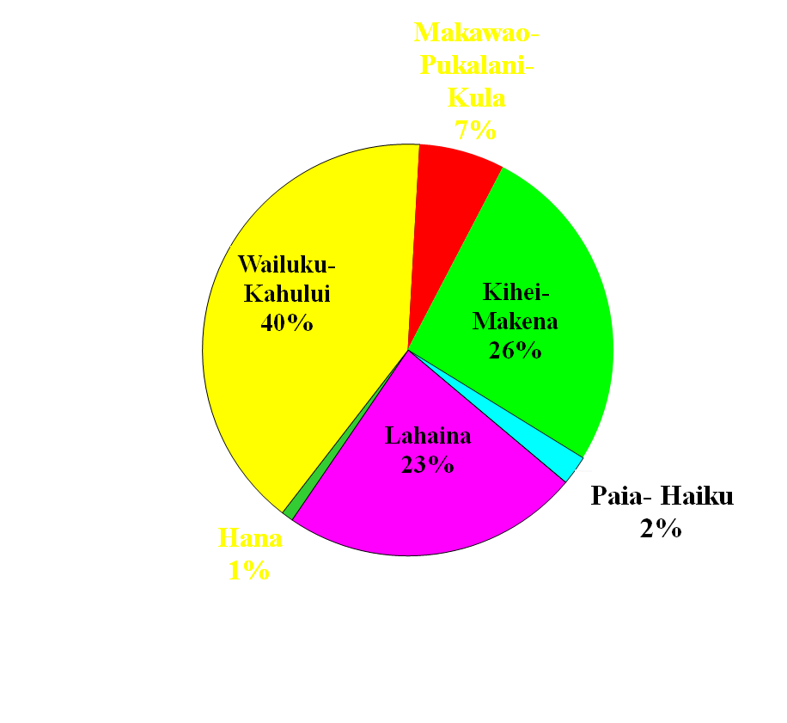
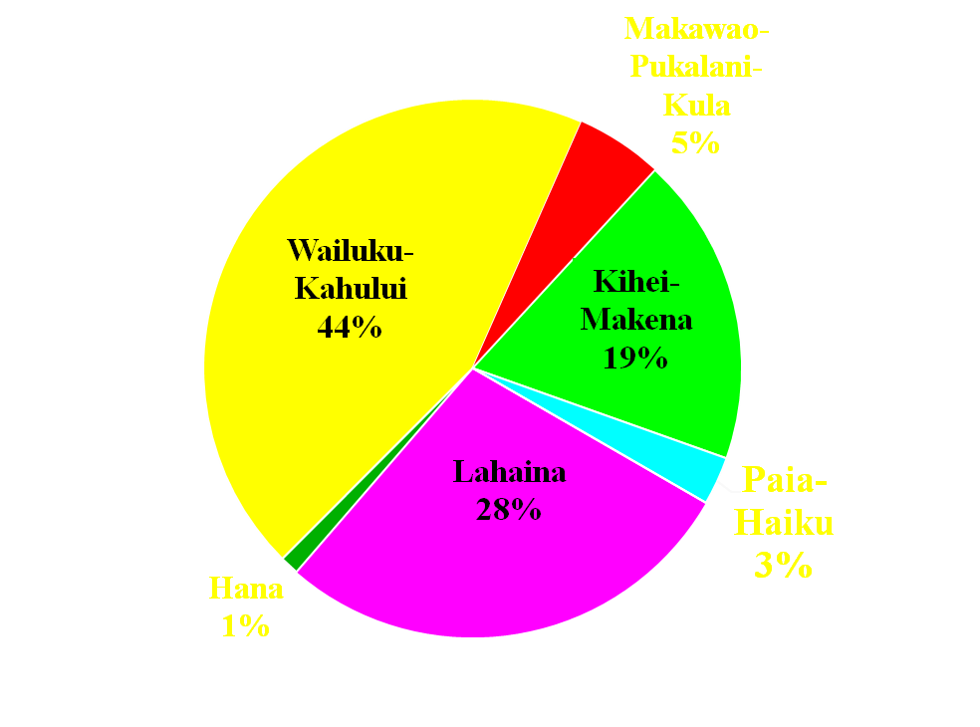
Where will jobs be located?
7% decrease in Wailuku-Kahului
37% increase in South Maui
versus
21% decrease in Lahaina
Paia-Haiku
2%
2000
2020
Notes:
<number>
Job Distribution Maui Regions 2000 & 2030

Slide 55
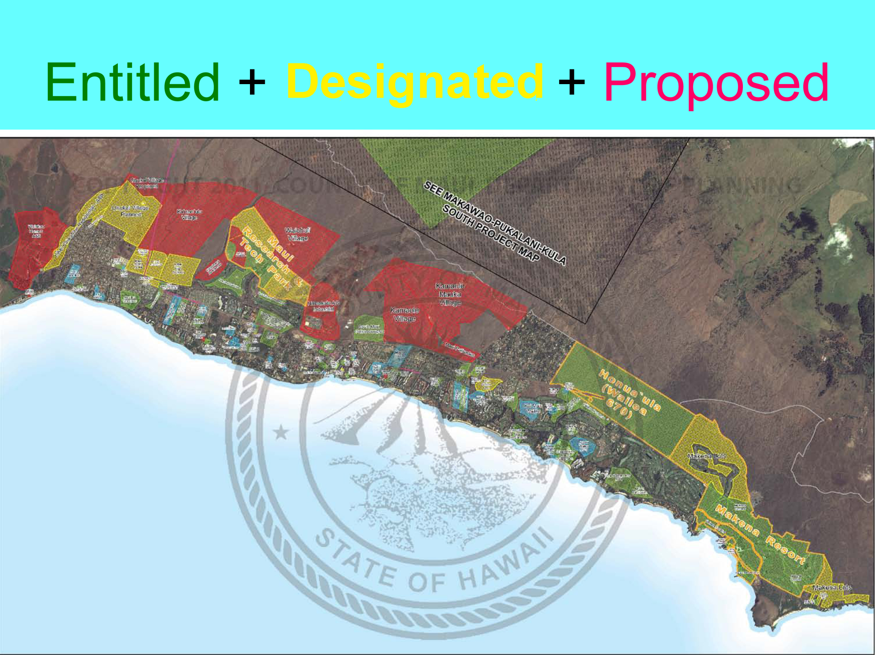
South Maui Development: An Overview
Completed Entitled Designated Proposed

Slide 56
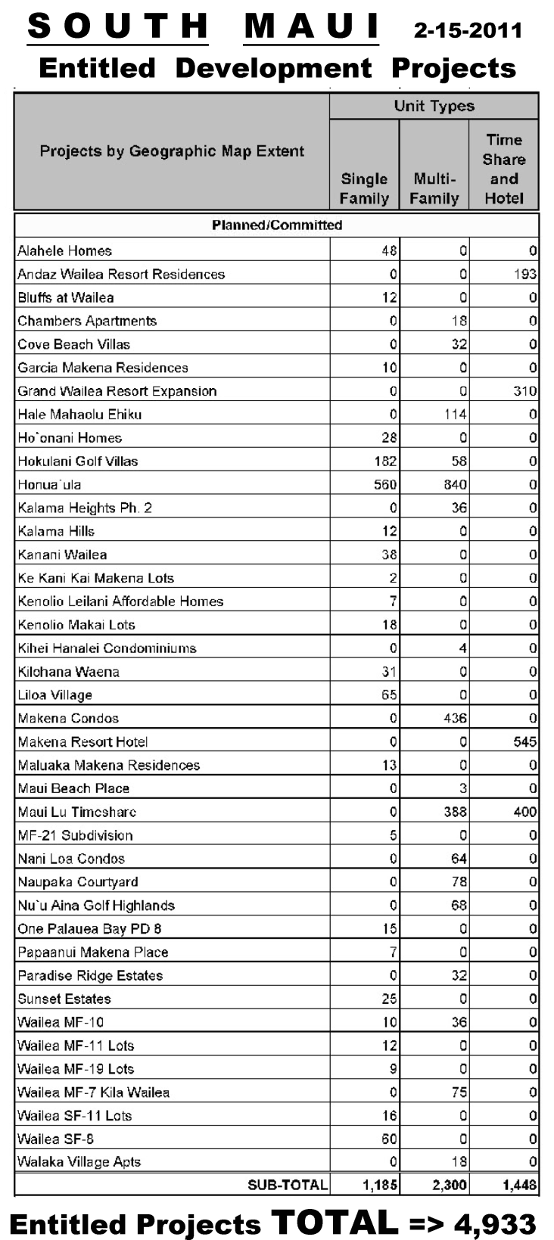
South Maui Already Contains Over 4,900
Entitled Development Projects

Slide 57
Existing “Entitled” Units
South Maui Already Authorized to Receive the Most New Housing Units Even Before A Single New Development is Approved
Unit counts do NOT include additional ohanas, small projects under five units, infill on vacant lots or any new agricultural subdivisions.
Source: Maui Planning Department, February 15, 2011

Slide 58
South Maui Development Options
(Maui Island Plan Recommended Additional Units )
Unit counts do NOT include additional ohanas, small projects under five units, infill on vacant lots or any new agricultural subdivisions.

Slide 59
Proposed South Maui Development

Slide 60
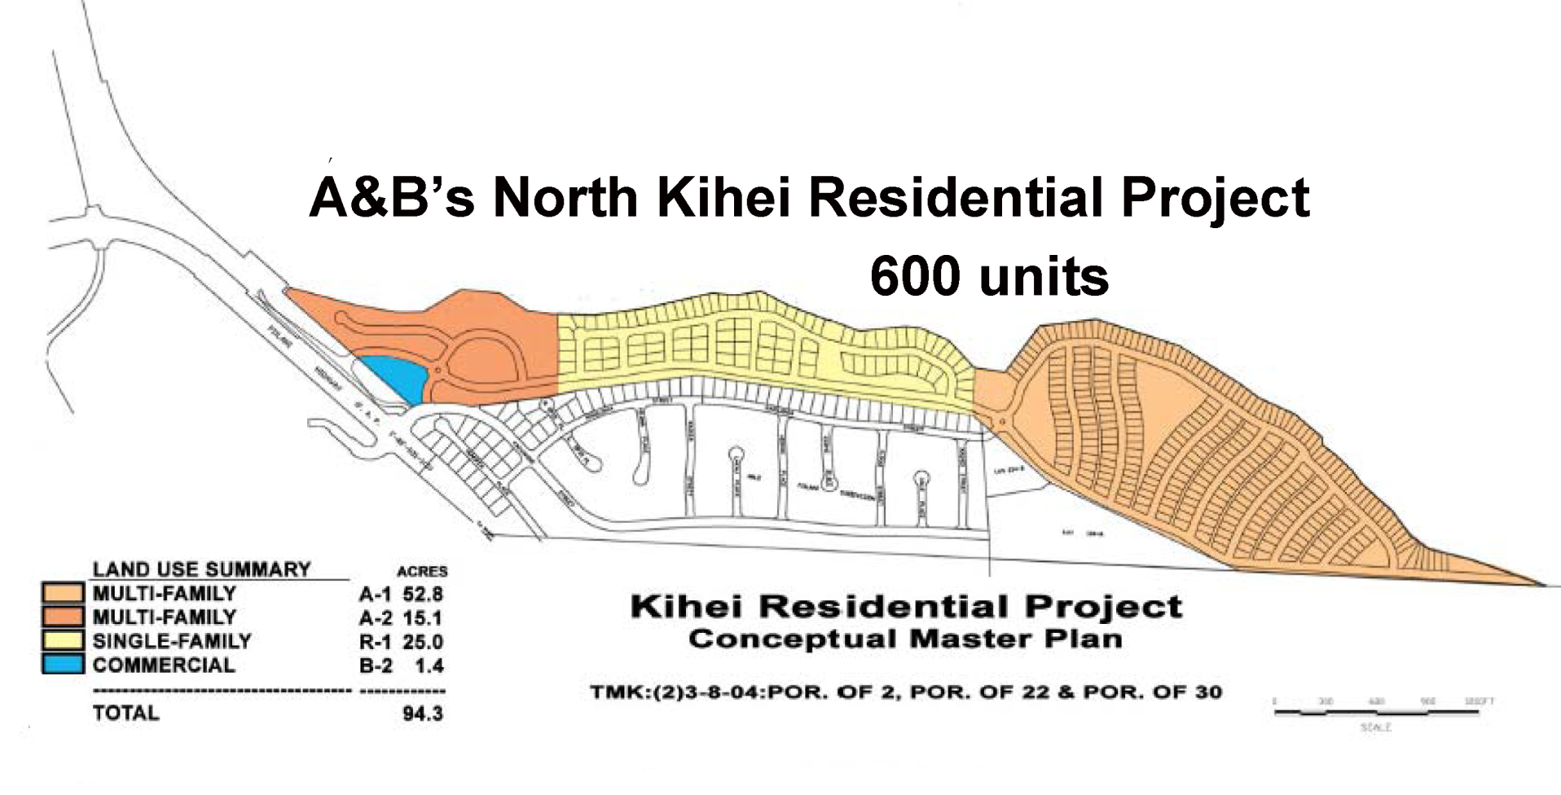
Proposed South Maui Developments
A & B’s North Kihei Mauka Residential & Commercial
New Piilani
Intersections

Slide 61
Proposed South Maui Developments
Changes Requested For A & B’s North Kihei Residential & Commercial Project

Slide 62
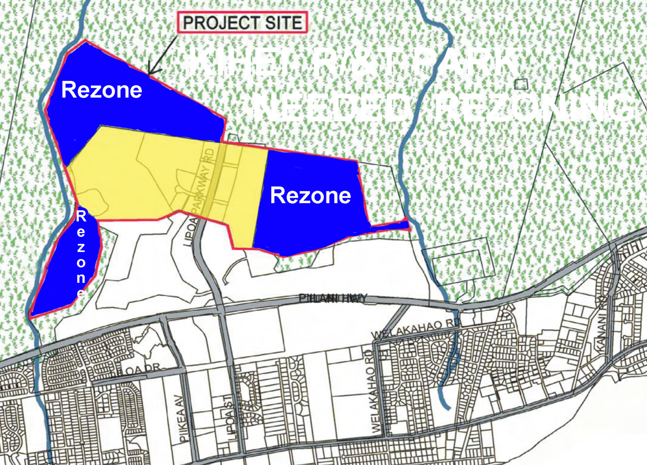
Proposed South Maui Developments
Maui Research & Technology Park Expansion

Slide 63
Proposed South Maui Developments
Maui Research & Technology Park Expansion

Slide 64
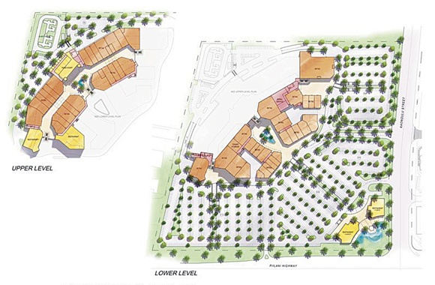
Proposed South Maui Developments
Outlet Mall
New Piilani
Intersections

Slide 65
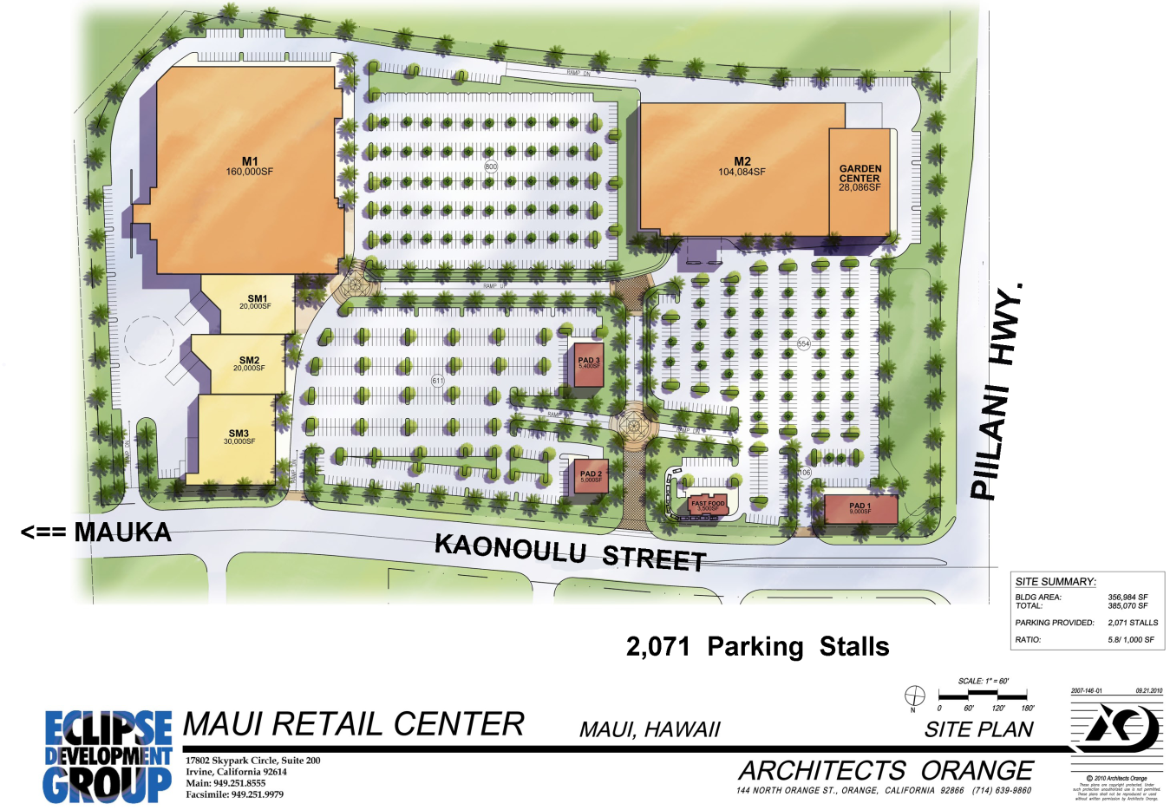
Proposed South Maui Developments
Big Box Retail Mall
2,100
Parking
Spaces

Slide 66
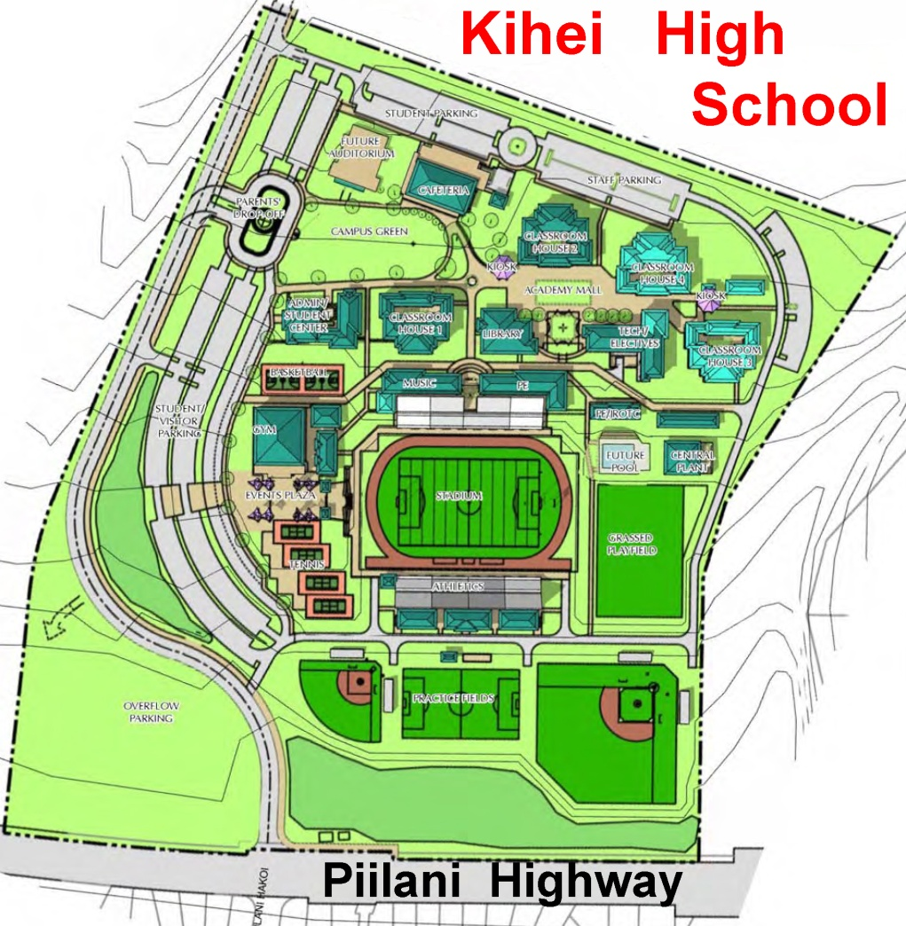
Proposed South Maui Developments
New Piilani
Intersection

Slide 67
Proposed South Maui Developments
Development south of Kilohana Street
Source: Pi’ilani Highway 2010 Draft EA—Appendix I

Slide 68
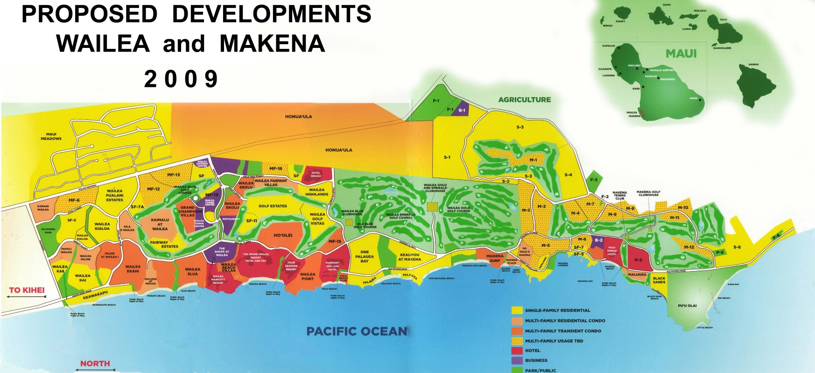
Proposed South Maui Developments
Wailea & Makena
(as of 2009)
Wailea 670
Construction
Road
Makena Resort
Kilohana

Slide 69
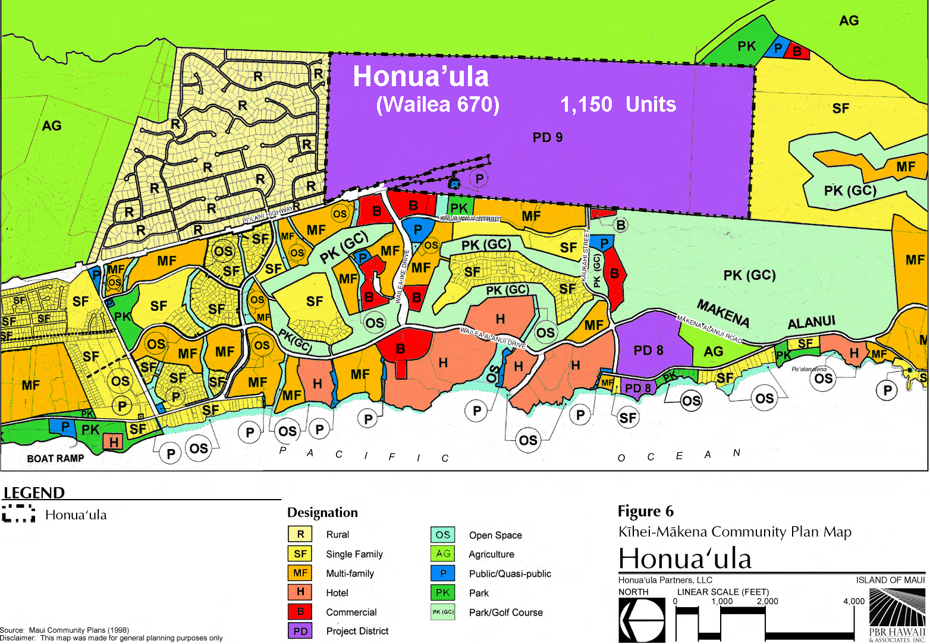
Proposed South Maui Developments
Wailea 670 & Makena Resort Build-out

Slide 70
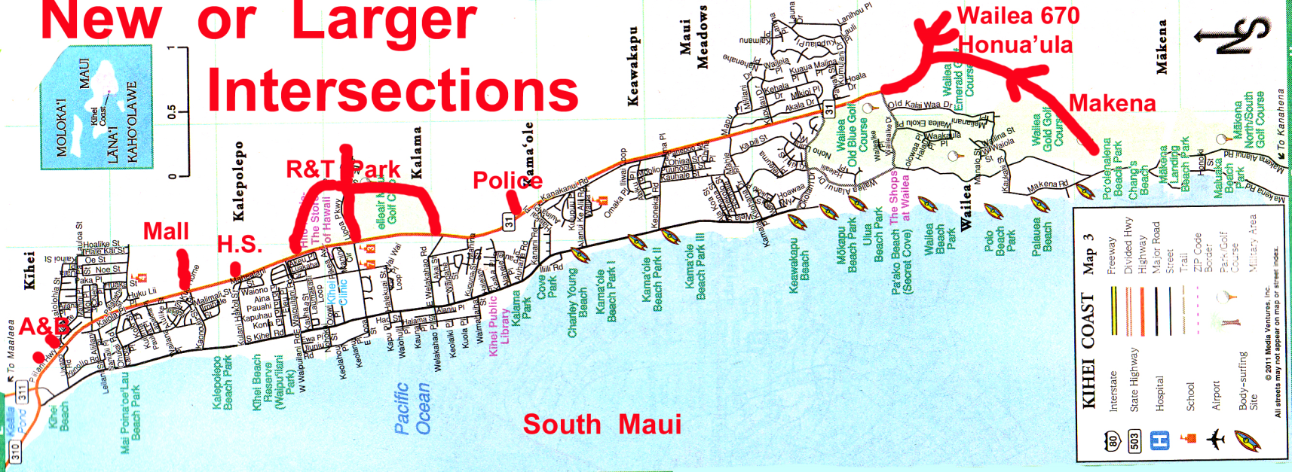
South Maui Road Effects
New or Larger Pi’ilani Highway
Intersections
A & B New Malls High School R& T Kihei Wailea Makena
Park Police 670 Buildout
Station

Slide 71
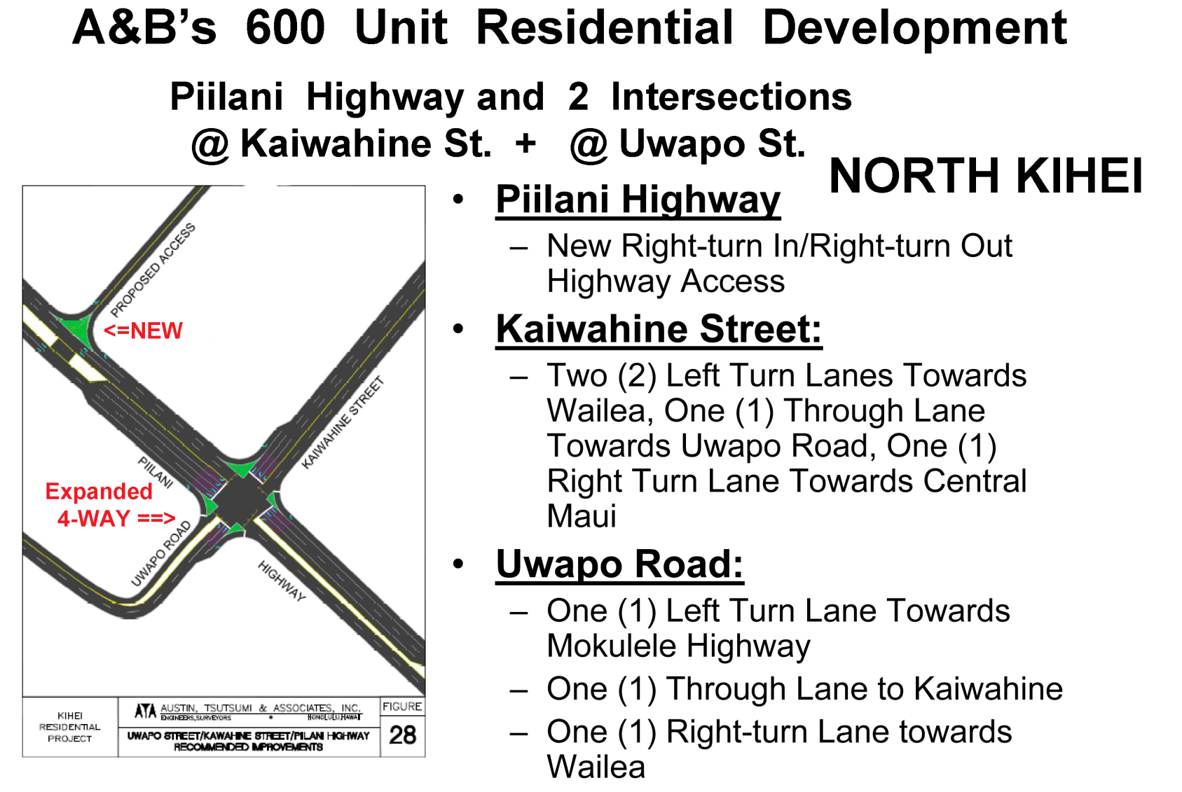
South Maui Road Effects

Slide 72
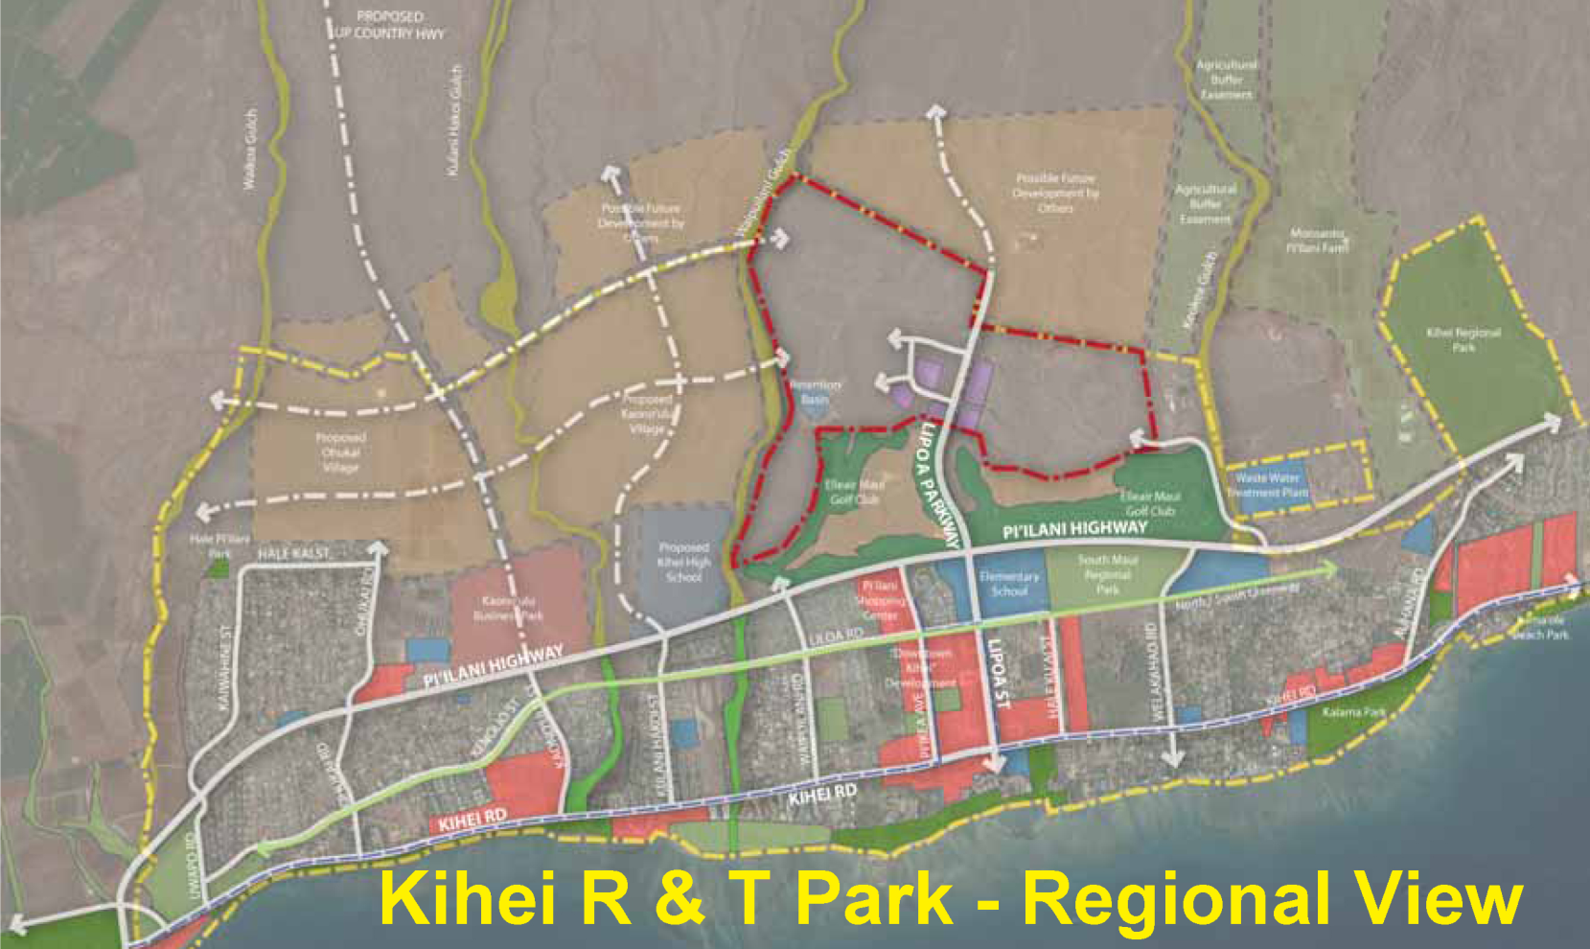
South Maui Road Effects
R & T Park Region Pi’ilani Road Mauka Road Projections

Slide 73
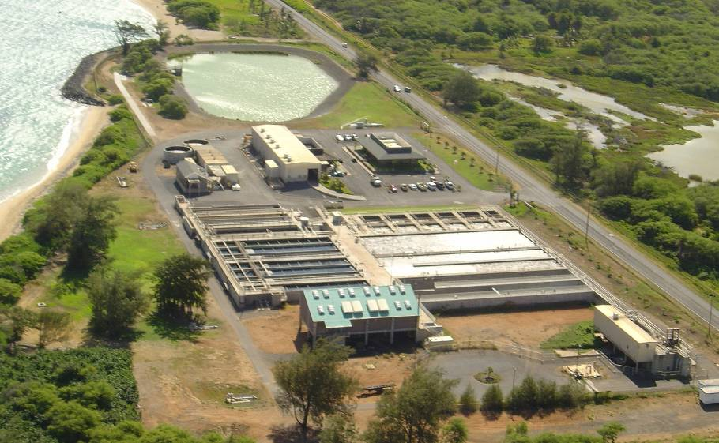
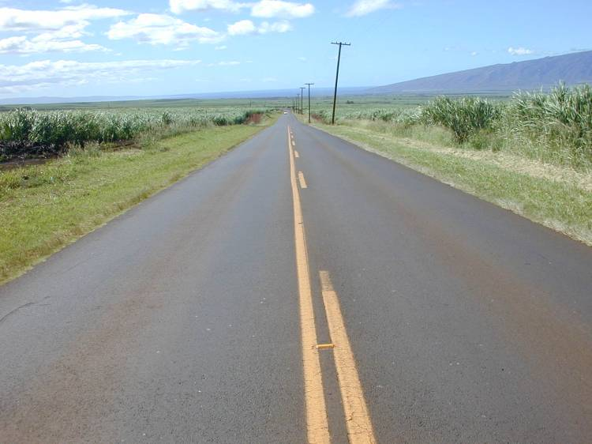
What Can Concerned Citizens Do?
Insist that concurrency planning—a requirement that infrastructure must be planned and funded before development can be approved and/or built.
But, where is the accountability that assures that these pre-conditions are met?
Notes:
<number>

Slide 74
Which Brings Us Back To The Question of Maui Nui’s “Tipping Point”?
Is it “To Pave Paradise and Put Up a Parking Lot”?
Or, is it:
A sustainable economy with a high percentage of Maui-produced food & energy;
Affordable housing for all;
Diversification of current and new jobs away from tourism & construction sectors and creation of “green-collar” jobs;
Retention and expansion of Maui’s historical
and cultural heritage and our precious environment.
Notes:
<number>

Slide 75
Which Brings Us Back To The Question of Maui Nui’s “Tipping Point”?
Is it “To Pave Paradise and Put Up a Parking Lot”?
Or, is it:
The choice is up to you!!
Okay, we agree, what do
we do next?
A sustainable economy with a high percentage of Maui-produced food & energy;
Affordable housing for all;
Diversification of current and new jobs away from tourism & construction sectors and creation of “green-collar” jobs;
Retention and expansion of Maui’s historical
and cultural heritage and our precious environment.
Notes:
<number>

Slide 76
Not every planning issue is covered here. Consider this an introduction to the broad choices South Maui residents must deal with over the coming months. Many more key questions—such as where urban growth boundaries will be placed—still remain.

Slide 77
Make sure your voice is heard!!
At Community Meetings
Before the County Council
During the on-going Maui Island Plan discussions

Slide 78
What Maui Nui as a whole—and South Maui specifically—becomes is our collective responsibility, our kuleanea!
Tipping points can move many ways and the more that movement is influenced by us, we can be assured that the result will be what we desire.
Mahalo

Slide 79
A PDF version of “South Maui At The Tipping Point” is available upon request from the PDF Archives section on the Maui-Tomorrow.org website.
Prepared by MJ Duberstein with much assistance from David Michaelson,
Dick Mayer and Lucienne DeNaie and the members of The Maui Tomorrow Foundation
August 2011

